Slide 1






INVENTRA
Intelligent Inventory Management System
Domain: Electronic Gadgets Shop (Laptops, Computers, Accessories)
Infosys Springboard | Virtual Internship 6.0 | Team 2

Slide 2






CRITICALITY OF MANAGEMENT
High-Value Items
Fast-Moving Goods
Electronic gadgets are expensive assets that require precise tracking to prevent capital leakage.
Accessories like chargers and SSDs move rapidly; depletion leads to immediate revenue loss.
Financial Integrity
Peak Hour Efficiency
Incorrect stock level detection directly causes financial discrepancies and budget misalignment.
Manual tracking methods consistently fail during high-traffic hours, causing customer dissatisfaction.

Slide 3
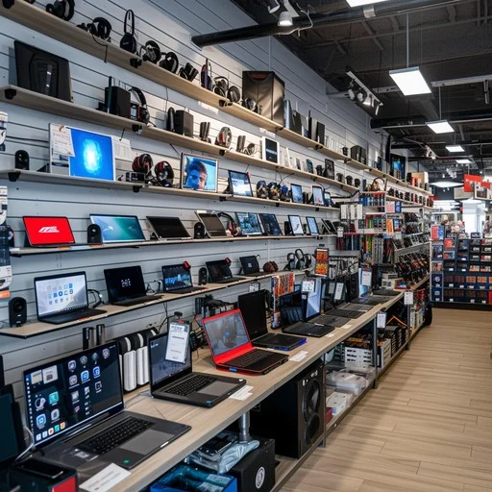

SHOP INVENTORY ENVIRONMENT
Core Products: Laptops, Keyboards, Mouse, Chargers, SSDs
Operational Flow: Multiple staff members handling inventory daily
Precision: Real-time stock accuracy is non-negotiable
Compliance: Accountability is essential for all updates

Slide 4
IDENTIFIED CHALLENGES
Duplicate Entries: Redundant gadget records causing data clutter.
Post-Sale Errors: Mismatch in stock levels immediately after transactions.
Zero Traceability: No historical record of which staff member updated specific items.
Late Detection: Low-stock alerts for accessories are delayed or missed.
Weak Access Control: Vulnerable security protocols for inventory modification.

Slide 5

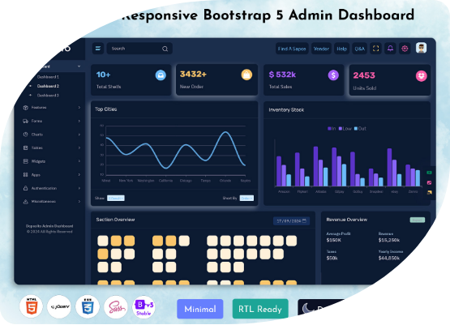
THE INVENTRA SOLUTION
Centralized System: One single source of truth for all branches.
RBAC: Secure role-based login for admin and staff.
Live Updates: Instantaneous stock adjustments.
Automated Alerts: Proactive notification for low-stock items.
Audit Trail: Complete transaction tracking for accountability.
Dashboard shown is a conceptual representation of the planned system UI

Slide 6








TECHNOLOGICAL FOUNDATION
Frontend
Backend
Middleware
Java with Spring Boot framework for robust business logic processing.
REST API architecture for seamless communication between components.
HTML5, CSS3, JavaScript for a
responsive and intuitive interface.
Security
Storage
Development
JWT (JSON Web Tokens), BCrypt password hashing, and RBAC.
MySQL relational database for structured and reliable data persistence.
IntelliJ IDEA as the primary Integrated Development Environment.

Slide 7


SYSTEM ARCHITECTURE
Request Flow
Controller Layer
Controller → Service → Repository → Database
Intercepts user requests and routes them to appropriate service handlers.
Service Layer
Repository Layer
Encapsulates core business logic, validation rules, and transaction boundaries.
Manages database interactions and data mapping via JPA/Hibernate.

Slide 8








CORE MODULES
Authentication
Inventory
Monitoring
Security and identity management.
Stock management and cataloging.
Real-time alerts and stock levels.
Transactions
Reports & Analytics
IN/OUT operation tracking.
Data-driven decision support and historical trends.

Slide 9

AUTHENTICATION
Secure login for Admin and Staff.
Role-Based Access Control (RBAC).
Industry-standard BCrypt encryption.
Zero tolerance for unauthorized access.

Slide 10


Authentication – Business Impact
Admin Privileges
Staff Operations
Full control over high-value laptop catalogs and store-wide settings.
Restricted access to daily stock updates for accessories and sales entry.
Unique Identities
Dispute Resolution
Strict "no-shared-accounts" policy ensures complete individual accountability.
Clear audit logs allow management to resolve stock discrepancies instantly.

Slide 11
INVENTORY MANAGEMENT OPERATIONS
Product Ingestion: Seamlessly add new electronic products with detailed specs.
Dynamic Adjustment: Automatic stock updates after every single sale or purchase.
Quantity Tracking: Real-time visibility of available shelf and warehouse stock.
Validation: Intelligent checks to prevent duplicate product entries and data corruption.

Slide 12
OPERATIONAL WORKFLOW
Stock IN
Stock OUT
Sync
Record
New Dell Laptops arrive; system logs entry.
Wireless Mouse sold; quantity decremented.
Database updated instantly across modules.
Transaction history logged for audit trail.

Slide 13


ALERTS & MONITORING
Automated Thresholds
Continuous monitoring of accessory stock levels against minimum safety margins.
24/7
Zero Revenue Loss
Stock Vigilance
Instant alert generation prevents "Out of Stock" scenarios during peak demand.

Slide 14
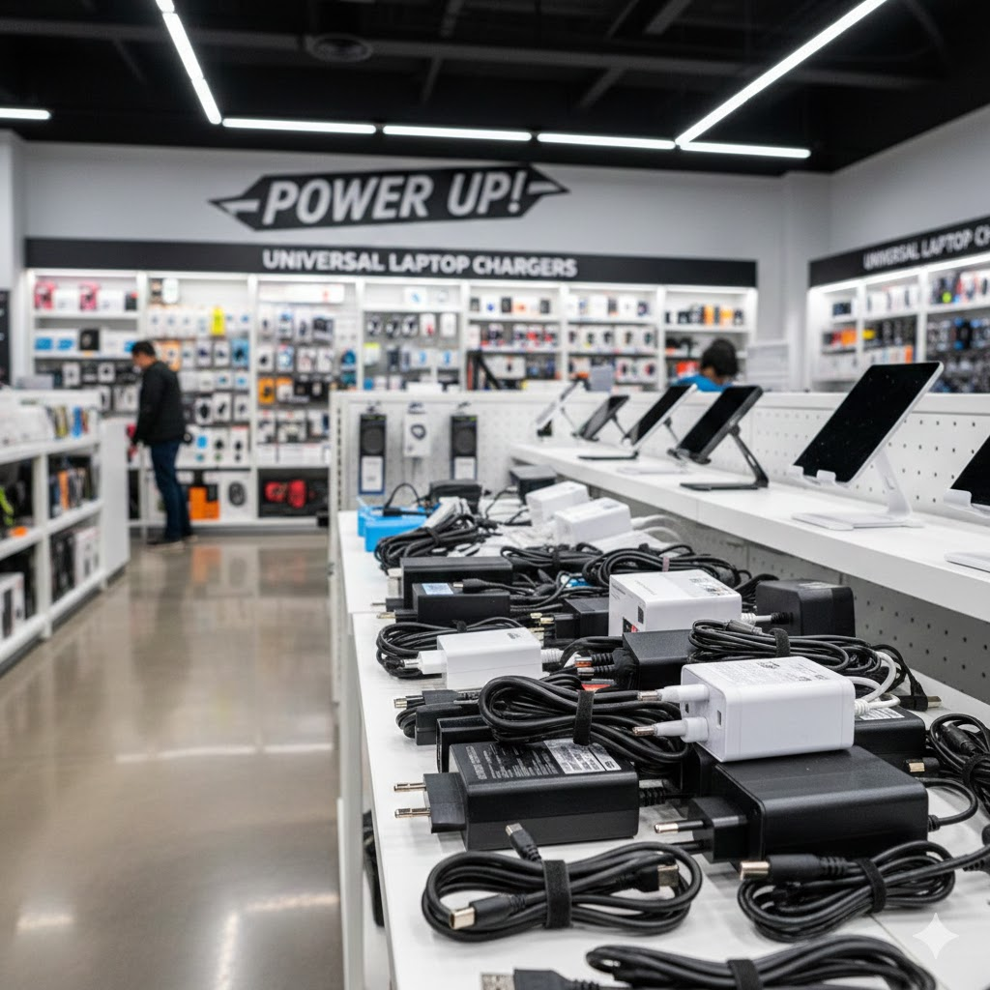
CASE STUDY:
LOW-STOCK MITIGATION
Scenario: Charger stock drops below 10 units.
System detects breach of threshold.
Alert generated for Admin dashboard.
Admin restocks before shortage impacts customers.
Representative product image for demonstration

Slide 15
TRANSACTION MANAGEMENT
Timestamp | Product | User | Type | Quantity
2026-02-02 10:15 | Dell XPS 15 | Admin | STOCK_IN | +15
2026-02-02 11:30 | Logitech Mouse | Staff_1 | STOCK_OUT | -05
2026-02-02 14:45 | Samsung SSD 1TB | Staff_2 | STOCK_OUT | -02
2026-02-02 16:00 | Laptop Charger | Admin | STOCK_IN | +50

Slide 16
WHY TRANSACTION LOGS MATTER ?
“
Transparency isn't just a feature; it's the foundation of trust. By identifying exactly who updated the laptop stock and when, we eliminate disputes and maintain a trusted operational record.

Slide 17


REPORT & ANALYTICS
Inventory Summaries: Periodic snapshots of total asset value.
Historical Trends: Track stock movement over weeks or months.
75% Efficiency Gain
Granular Analysis: Product-wise performance metrics.
Strategic Support: Data-driven insights for procurement.

Slide 18
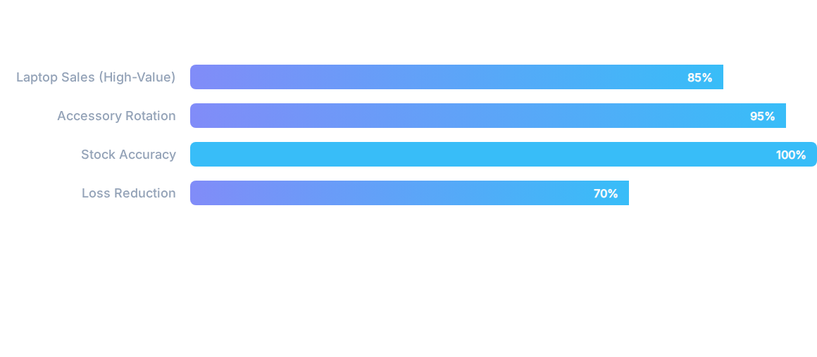
ACTIONABLE INSIGHTS
INVENTRA allows management to identify fast-selling accessories and plan laptop restocking with mathematical precision.

Slide 19







THE INVENTRA ADVANTAGE
Accuracy
Security
Automation
Elimination of human error in stock counting.
Multi-layered RBAC and data encryption.
Intelligent alerts and real-time syncing.
Audit Trail
Loss Prevention
100% traceability for every transaction.
Significant reduction in manual errors and shrinkage.

Slide 20


DOMAIN BENEFITS
Better control of high-value electronic gadgets and fragile inventory.
Avoid frequent accessory stock-outs during major tech releases.
Faster decision-making for inventory procurement and pricing.
Dramatically improved operational efficiency for retail staff.

Slide 21
Conclusion
INVENTRA is a purpose-built solution for the modern electronic gadget ecosystem. By ensuring accuracy, security, and transparency, it not only reduces operational losses but also provides a scalable foundation for future business expansion.

Slide 22





Thank You
Any Questions?
Project Developed by Team 2
Infosys Springboard Virtual Internship 6.0

